Slide 1
Direct Business Intern Project Summary Report
Ken Chiang 江晨立
Direct Business Division / Customer & Service Section
Regtech Development and Data Analysis Intern

Slide 2
Basic Data Analysis Procedure
Database
More than
70% Time
30% Time
Sales
Assistance
Data
Processing
Data
Analysis
Decision
Making
Data
Visualization
Modeling
30% Cases
70% Cases
30% Cases
Source : DCB Intern Moss Final Presentation

Slide 3
Outline
(1.) EDD 客戶交易態樣月報表
AML
(2.) EDD 客戶交易分析
(1.) Week Sales Report
C&I
(2.) Sales performance score
DB Intern
(2021/07~2021/12)
(3.) Customer Portfolio Allocation
Auto Invest Research - Timing Market
Digital
Technical Indicator
Application for Fund
(1.) Big EC
Institution
(2.) 基金觀測站 Crawler
(3.) 政府基金 Pdf → Excel

Slide 4
AML – EDD 分析

Slide 5

EDD 態樣報表過濾
把所有態樣報表的資料作為 Input Data
快速判別出 EDD 風險客戶名單
該月的異常交易行為
在態樣報表過多的 EDD 客戶
EDD 客戶交易分析
戶號 | 戶名 | 報表月份 : 202109 | 出現態樣次數 | Division
140838 | 王圭容 | #14 | 1 | DB
98686 | 聯邦商業銀行股份有限公司 | #13 | 1 | DB
311261 | 林瑞凱 | #11 #13 #13R #14 #14R #15 #15R #6 #6R #7 #7R | 419 | DB
312148 | 白冬英 | #13R #14R #15 #15R #6R #7 #7R | 355 | DB
2195 | 台北富邦商業銀行股份有限公司 | #6 | 1 | DB
252326 | 南山人壽保險股份有限公司 | #6R | 15 | DB
98854 | 柳伊湄 | #15R | 2 | DB
87432 | 林宜裕 | #15R | 2 | DB
83783 | 台中商業銀行股份有限公司 | #13 | 2 | DB
237726 | 劉騰隆 | #13R | 3 | DB
312150 | 林逸宣 | #13R #14R #15R #6R #7R | 357 | DB
312151 | 林逸祐 | #11 #13R #14R #15 #15R #6R #7R | 365 | DB
318643 | 梁愷 | #15R | 2 | DB
322903 | 黃謙 | #13R #21R #7R | 20 | DB
322904 | 莊榆棼 | #21R | 5 | DB
322905 | 林淑齡 | #13R #21R #7R | 19 | DB
322906 | 何珮綺 | #21R | 7 | DB
320628 | 林姿君 | #13R #21R #7R | 20 | DB
320630 | 陳梅鳳 | #13R #21R #7R | 20 | DB
320679 | 楊秋桂 | #13R #21R #7R | 20 | DB
320681 | 蔡惠如 | #21R | 5 | DB
320714 | 張麗美 | #21R | 1 | DB
320868 | 陳梅君 | #13R #21R | 7 | DB
321005 | 林惠玲 | #13R #21R #7R | 20 | DB
321007 | 陳麗如 | #13R #21R #7R | 20 | DB
321008 | 蔡慧琳 | #21R #7R | 18 | DB
321161 | 康美蝶 | #21R | 5 | DB
321162 | 鄢琳麗 | #21R | 7 | DB
321297 | 若琦 | #13R #21R #7R | 20 | DB
321298 | 吳麗紅 | #13R #21R #7R | 20 | DB
322157 | 黃秀雯 | #13R #21R #7R | 22 | DB
321619 | 劉慧雯 | #13R #21R #7R | 9 | DB
323023 | 蔡幸桑 | #21R | 2 | DB
323137 | 豐聖興業股份有限公司 | #13R | 3 | DB
323352 | 謝慧敏 | #21R | 5 | DB
323354 | 鍾宜靜 | #21R | 1 | DB
322009 | CANVAS AGENTS LIMITED | #6R #7R | 39 | DB
99077 | 林季臻 | #7R | 19 | CB

Slide 6
EDD 客戶交易分析

Slide 7
EDD 客戶交易分析

Slide 8
C&I – Sales Report ,
Sales Performance ,
Customer Portfolio

Slide 9

Sales Report & Sales Performance
Sales Assistance
Database
Weekly Sales Report
Extract
Excel
Data
Current AUM
Management &
Transaction Fee
Weekly Fund Performance
Average AUM
Month Reactive
Customer
Foc & Pro Fund Performance
Foc & Pro Fund Performance
Number of AUM by Sector
Sales & Customer Contact Report
Offshore Fund by Company
Weekly
Sales Report
Calculate Key Performance

Slide 10
Sales Report & Sales Performance
Sales Assistance
Database
Calculate Key Performance
R/C
Revenue 近期成長率
Revenue 近3年成長率
Extract
Excel
Data
AUM
AVG AUM 近期成長率
AVG AUM 近3年成長率
Revenue
申贖人數
申贖金額
帳上客戶數
New Account
New Reactive
Weekly
Sales Report
Calculate Key Performance
Sales
Values
Client
Development

Slide 11
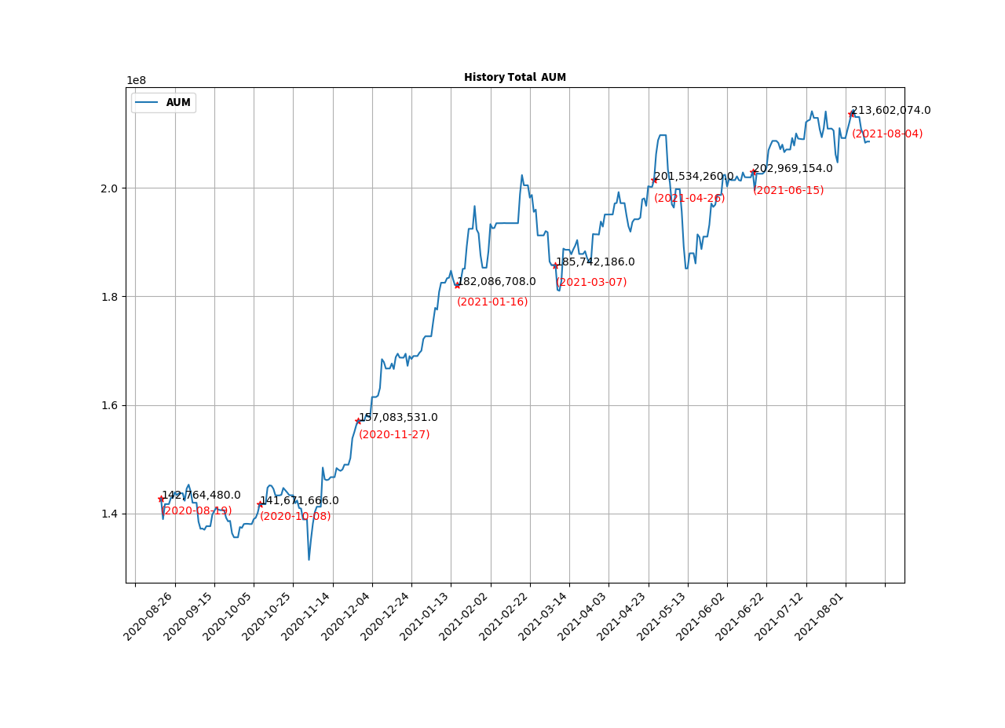
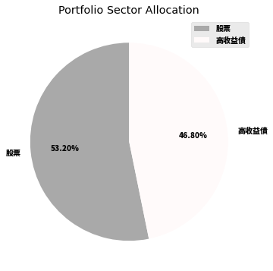
Customer Portfolio (Not yet Finish)
(1.) Construct Customer Rolling AUM with more efficient way .
(2.) Pi Chart For Current Holding Assets and Recommend Portfolio Allocation
(3.) Past and Current Fund Performance with dividends .
Recommend Portfolio Allocation
80% : 股
20% : 債

Slide 12
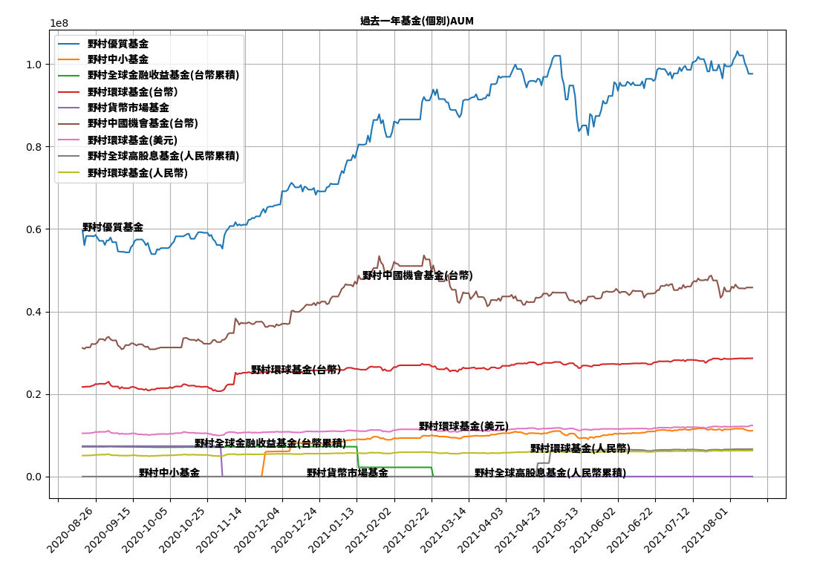
Customer Portfolio (Not yet Finish)
(1.) Project Feasibility ?
(2.) Where are all these data ?
(3.) Experiment with Python .
(4.) Feedback with pros and cons .

Slide 13
Digital – Auto Invest Research

Slide 14
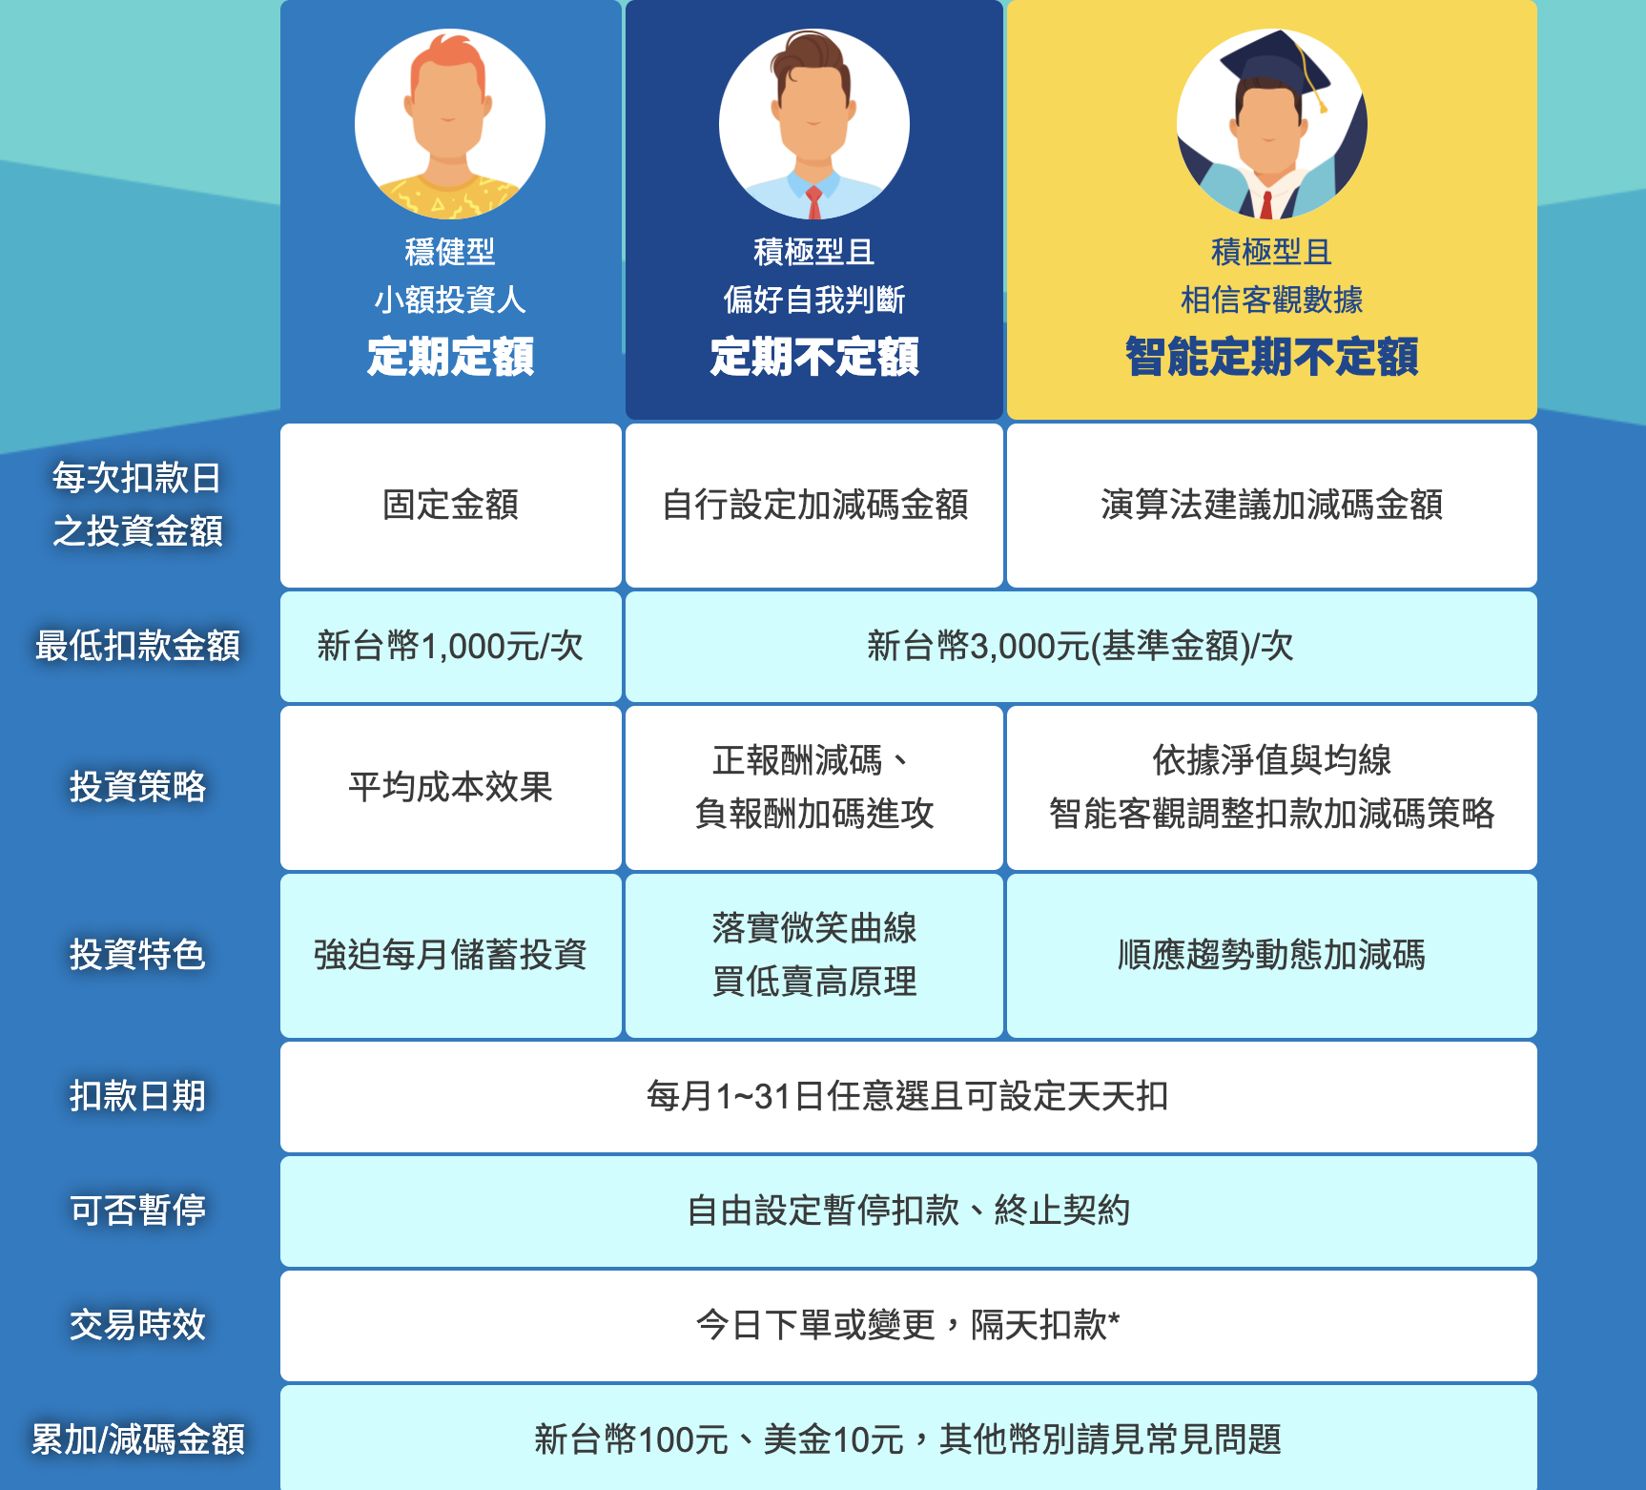
定期定額 , 定期不定額 , 智能定期不定額

Slide 15
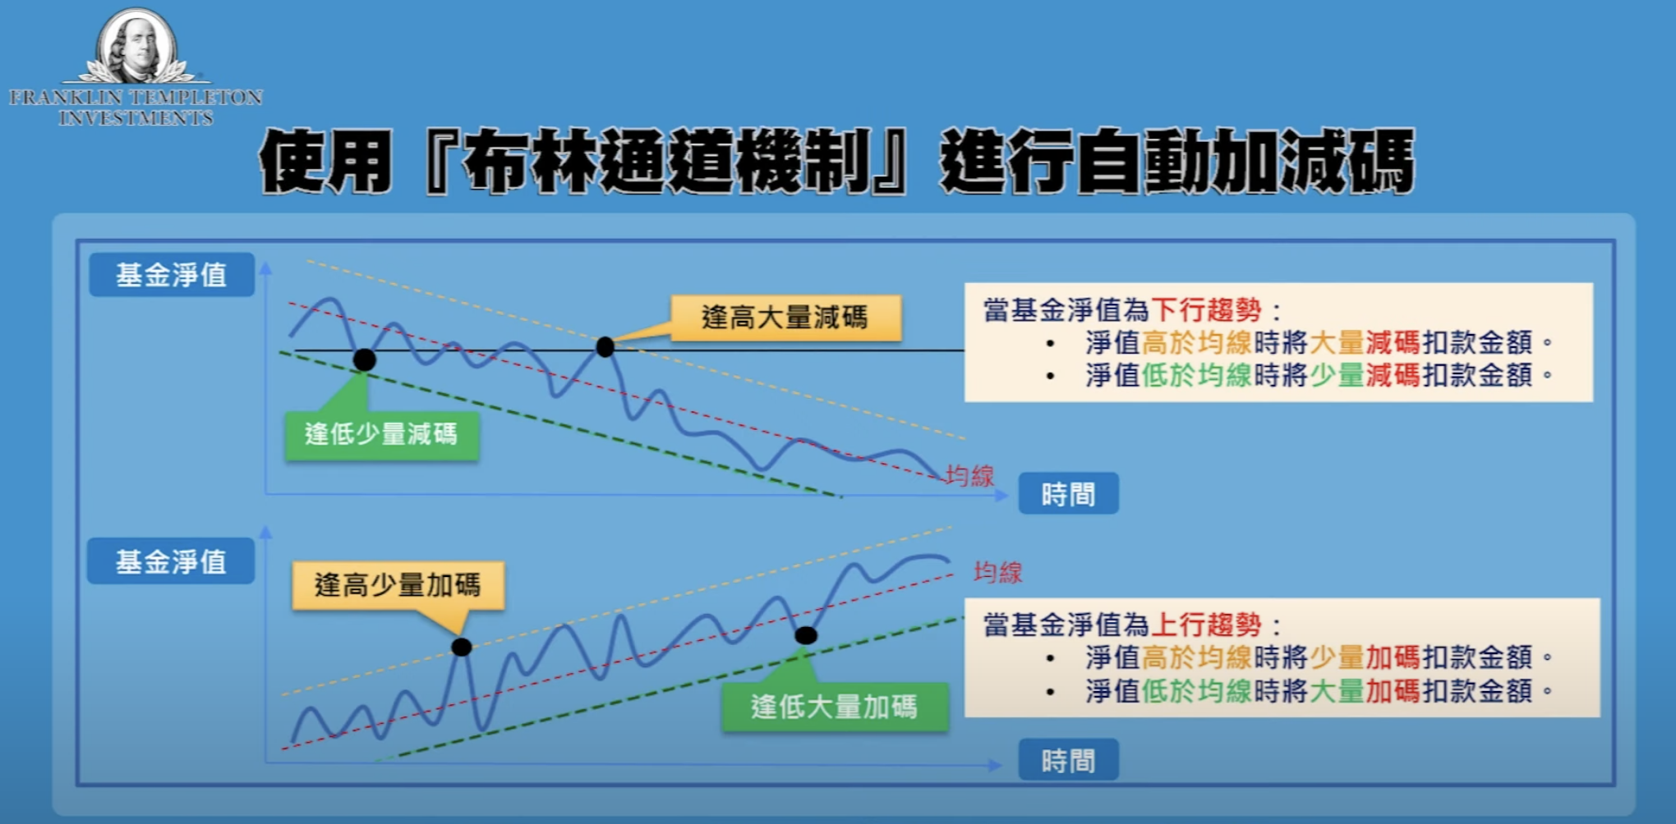
智能演算法--定期不定額
下跌時候的低點 （好）
下跌時候的高點 （壞）
上漲時候的高點 （壞）
上漲時候的低點 （好）

Slide 16
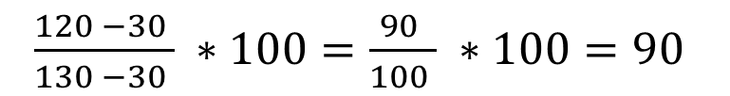
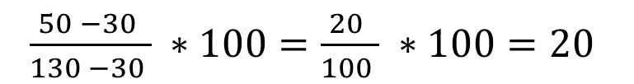
KDJ 計算方式 - RSV
RSV = $\frac{( 收盤價 − 最近 n 天的最低價 ) }{（最近 n 天的最高價 − 最近n天的最低價）} ∗100$
Example
$\frac{120 −30 }{130 −30 } ∗100=\frac{90 }{100 } ∗100=90$
, 目前價格偏貴
$\frac{50 −30 }{130 −30 } ∗100=\frac{20 }{100 } ∗100=20$
, 目前價格偏便宜

Slide 17
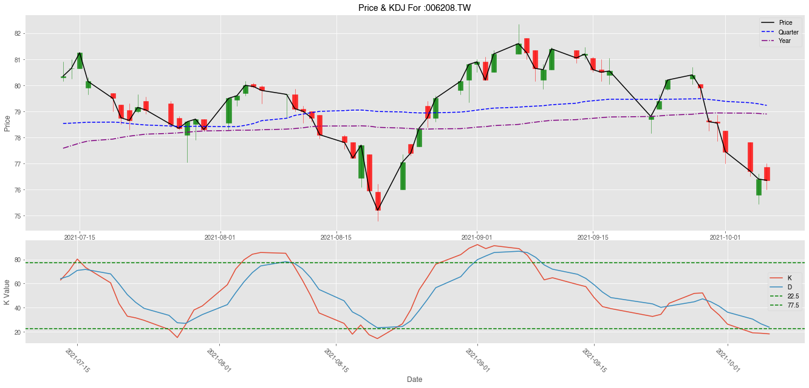
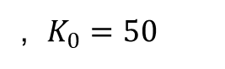
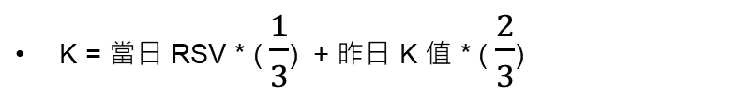
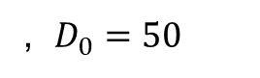
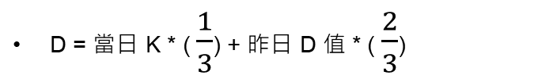
KDJ 計算方式 - KD
K = 當日 RSV * ( $\frac{1}{3}$) + 昨日 K 值 * ( $\frac{2}{3}$)
, $K_{0}=50$
黃金交叉
概念類似：MACD
D = 當日 K * ( $\frac{1}{3}$) + 昨日 D 值 * ( $\frac{2}{3}$)
, $D_{0}=50$
J = 3D – 2 K
死亡交叉
黃金交叉

Slide 18
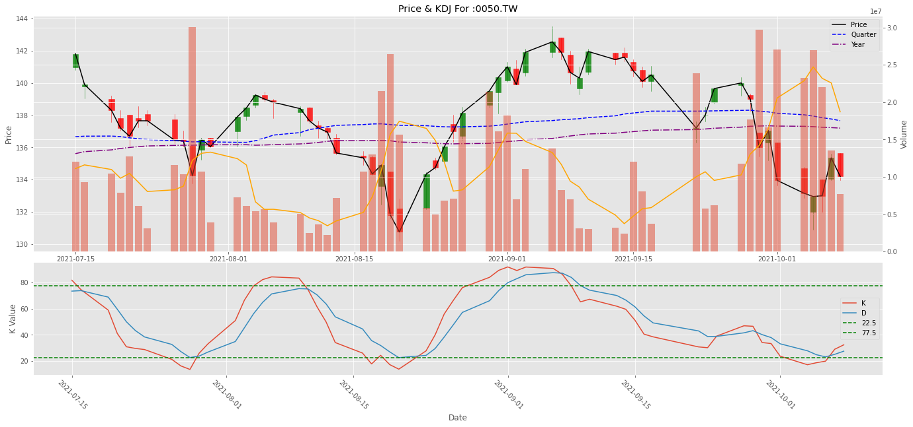
Example : 0050.TW

Slide 19
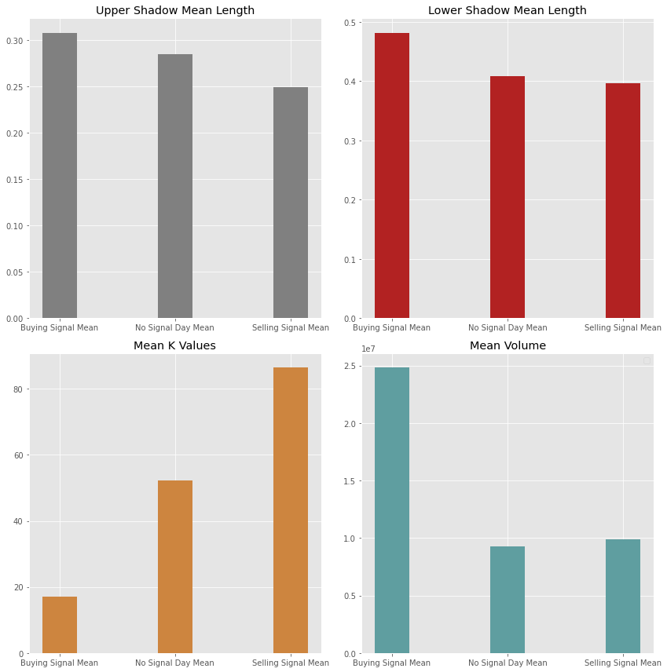
Example : 0050.TW

Slide 20
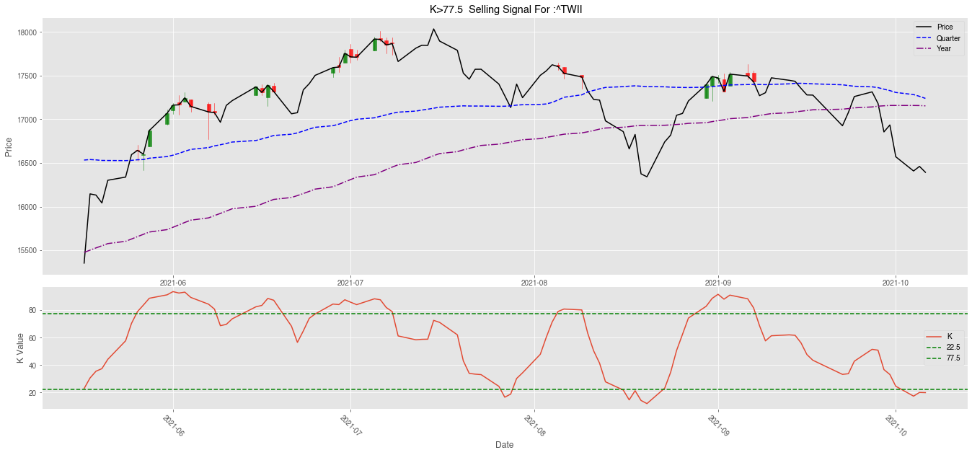
Some KDJ Strategy Drawback
n 天 k > 80 , 技術指標有高檔鈍化的疑慮
n 天 k < 20 , 技術指標有低檔鈍化的疑慮
一個月內可能有多次訊號 , 需要擔憂手續費問題

Slide 21
Data Difference Between Active Management Fund And Exchange Traded Fund
Exchange Traded Fund
Nomura‘s Fund

Slide 22
Mapping Equation to Nomura’s Fund
原本 RSV = $\frac{( 收盤價 − 最近 n 天的最低價 ) }{（最近 n 天的最高價 − 最近n天的最低價）} ∗100$
1. Proxy RSV For 最近n天的最高(低)價
2. 因為基金沒有 High , Low , 所以只能用淨值資料去代替
基金 RSV = $\frac{( 目前淨值 − 最近 n 天淨值的最低價 ) }{（最近 n 天淨值的最高價 − 最近n天淨值的最低價）} ∗100$
基金的 K , D , J

Slide 23
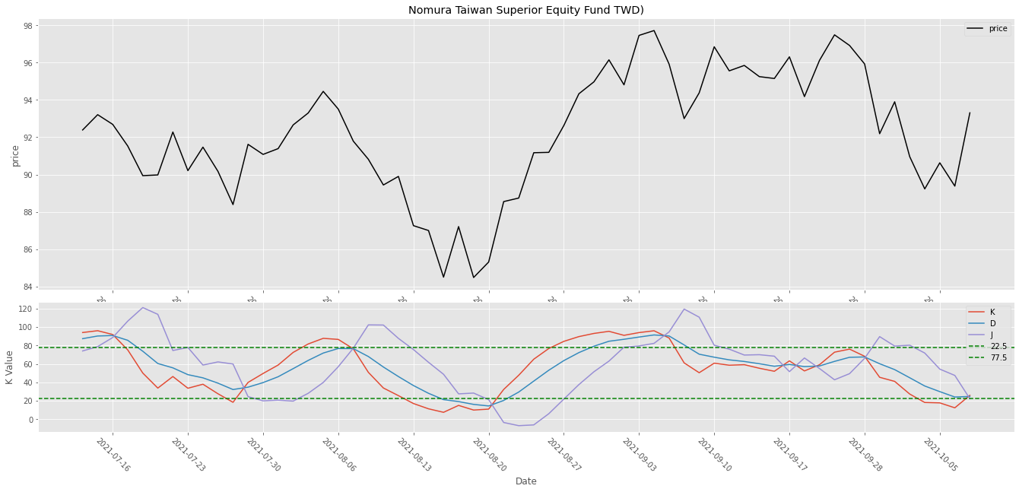
Example : 野村優質

Slide 24
Example : 野村優質
Sell
Sell
Buy
Buy
Buy
2021/07 ~ 2021/10

Slide 25
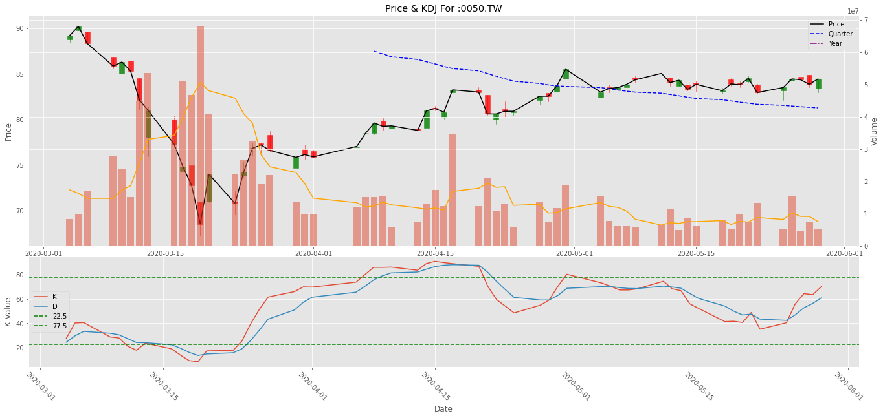
Performance Compare During : 2020/01 ~ 2020/06
 | Month Maximum Drawdown | Maximum Drawdown | Cumulative Return | 累積單位 | 累積市值(NTD) | 累積成本(NTD) | 投資損益(NTD) | 到期報酬率
定期定額 | 18% | 24% | -3% | 231 | 19,490 | 20,000 | - 510 | -3%
K值加減 | 16% | 22% | -2% | 233 | 19,666 | 20,000 | - 334 | -2%

Slide 26
Institution – Big EC (Monthly) ,
基金觀測站 Crawler (Monthly),
政府基金 Pdf

Slide 27
Big EC Monthly Report Outline
1. Monthly Onshore ILP Mandate Wallet Share Report
(1.) Share by site – (Top 20)
(2.) Share by account – ( Top 17 , on AIA List )
(3.) Top 5 Holding Funds in ILP
2. Monthly Offshore ILP Mandate Wallet Share Report
(1.) Share by site – (Top 20)
(2.) Share by account – ( Top 27 , AIA List & 精彩網 )
(3.) Top 5 Holding Funds in ILP
3. New Issue Accounts In Current Month

Slide 28
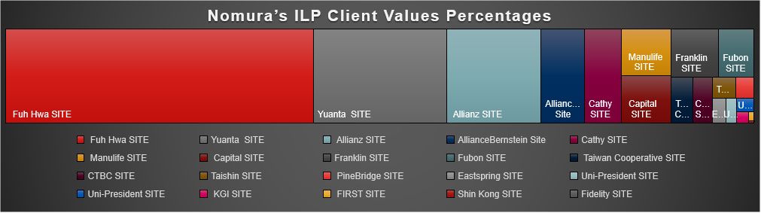
Quick Overview with Data Visualization

Slide 29
Top 5 Funds of Onshore ILP contracts
Top 5 Funds by AUM size of ILP contracts are list below,
4 Nomura funds are included in AIA List 17 ILP contracts.
基金 | Fund Numbers | Account size
野村環球基金-S類型新臺幣計價 | 5 | 6,849,273,766
復華已開發國家300股票指數基金-新台幣 | 5 | 6,428,201,800
復華美元高收益債券指數基金-新臺幣A | 5 | 4,192,570,000
復華全球大趨勢基金-新臺幣 | 2 | 3,302,562,463
柏瑞全球策略高收益債券基金-I類型 | 5 | 3,164,396,700
基金 | Fund Numbers | Account size
野村環球基金-S類型新臺幣計價 | 5 | 6,849,273,766
野村全球金融收益基金 | 1 | 183,592,553
野村美利堅高收益債基金 | 1 | 122,416,030
野村環球高收益債基金 | 1 | 120,667,229

Slide 30

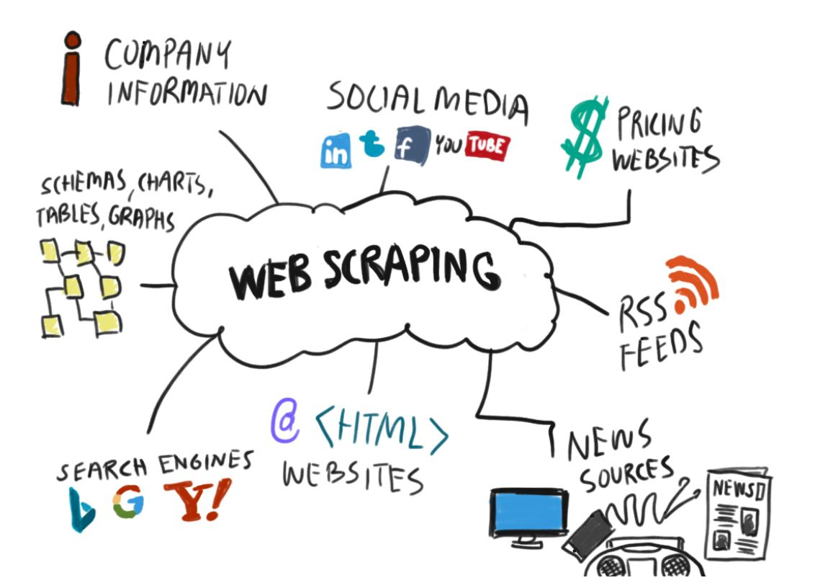

基金觀測站 Crawler
Fig Source: https://blog.apify.com/what-is-web-scraping/

Slide 31
Offshore Top 20 Fund Analysis

Slide 32
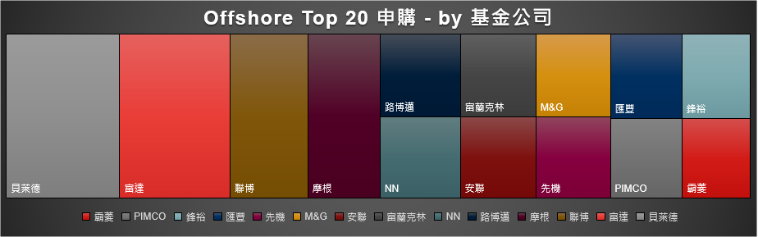
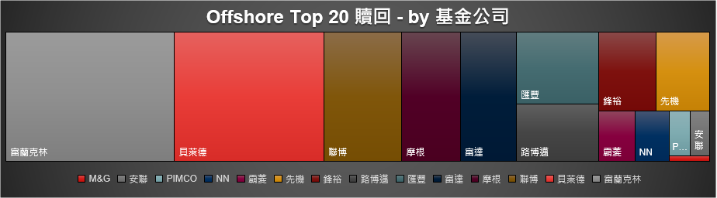
Offshore Top 20 Fund Analysis

Slide 33
Basic Data Analysis Procedure
Any Website
Data can be our
Database
More than
70% Time
30% Time
Any Website
Data
Processing
Data
Analysis
Decision
Making
Data
Visualization
Modeling
30% Cases
70% Cases
30% Cases
Source : DCB Intern Moss Final Presentation

Slide 34
Thank you for listening !
You can't connect the dots looking forward;
you can only connect them looking backwards.
Ken Chiang 江晨立
Direct Business Division / Customer & Service Section
Regtech Development and Data Analysis Intern
2021/01~06

